Slide 1
Snow crab fecundity

Slide 2
Predictors of snow crab fecundity
Weight precision
Explanatory variables
Sample count
Sample weight
Total egg weight
Crab size
Size precision
Estimation variables
Maturity stage
Hepatopancreas
Reproductive cycle
Gonad
Fecundity
Spatio-temporal effects
Egg stage
Sampling loss
Egg age
Egg loss
Egg mortality
Parasites
Gonad condition
Predation
Observed
Partially observed (later years)
Crab condition
Unobserved

Slide 3
Environment
Crab size
Maturity stage
Year of incubation
Health
Parasites
Oocyte production
Fertilization
Environment
Egg loss
Observed Fecundity

Slide 4
Table of observed snow crab fecundity data variables:
Variable | Field name | Description | Units
Weight precision | weight.precision | Balance precision (e.g. +/- 0.1 mg). | g
Size precision | Size.precision | Vernier caliper precision (e.g. +/- 1 mm). | mm
Total egg weight | egg.weight.total | Weight of whole egg mass (dried and cleaned). | g
Sample weight | egg.weight.sample | Weight of sub-sample egg mass (dried and cleaned). | g
Sample count | egg.count.sample | Number of eggs in sub-sample (generally 500-1000).
Crab size | carapace.width | Crab carapace width. | mm
Gonad weight | gonad.weight | Gonad weight (wet). | g
Shell condition | shell.condition | Carapace condition (e.g. new, medium, old).
Missing legs | missing.legs | Missing / regenerated leg pattern (e.g. ‘1**2**11**’).
Egg stage | egg.stage | Egg development stage. | 1-14
Egg colour | egg.colour | Qualitative colour or colorimeter (Lab) measurement.
Gonad weight | gonad.weight | Gonad weight (dissected, wet) | g
Gonad colour | gonad.colour | Qualitative colour or colorimeter (Lab) measurement.
Hepato weight | hepato.weight | Hepatopancreas weight (wet). | g
Hepato colour | hepato.colour | Qualitative colour or colorimeter (Lab) measurement.
Parasites | parasite | Presence or absence of parasites in the egg mass.
Observed
Partially observed

Slide 5
Table of unobserved snow crab fecundity data variables:
Variable | Field name | Description | Units
Fecundity | fecundity | Estimated number of eggs in total egg mass.
Maturity stage | maturity.stage | Maturity stage (e.g. primiparous, multiparous, senile).
Reproductive cycle |  | Type of reproductive cycle (annual or biennial).
Incubation year |  | Year of incubation in a two-year cycle.
Crab condition |  | Index of crab health (e.g. energy reserves).
Egg loss |  | Fraction or number of eggs lost since extrusion.
Egg age |  | Elapsed time since extrusion.
Sampling loss |  | Fraction or number of eggs lost due to sampling.
Egg mortality |  | Fraction or number of eggs lost due to mortality (e.g. due to parasites).

Slide 6
Working definitions:
Fecundity refers to the number of eggs laid by an individual female. Note that individual fecundity can decrease over the period of incubation, due to loss of eggs by various processes (failure to attach, unfertilized eggs, predation).
Maturity stage : For the purposes of this study, the maturity of females were categorized into one of the following stages:
Immature : Sexually immature with no visible gonad development (i.e. white or beige).
Pubescent : Sexually immature with developing orange gonad.
Primiparous : Sexually mature carrying first egg clutch, extruded just after terminal moult.
Multiparous : Sexually mature carrying second or third egg clutch.
Senile or Senescent : Sexually mature but showing signs of poor condition and reduction of fecundity.
Reproductive cycle refers to whether the period that eggs are incubated lasts one (annual cycle) or two years (biennial cycle) in duration, before being released as larvae.
Maturity age refers to the elapsed time since the terminal moult occurred.
Incubation year refers to whether eggs were laid in 1st or 2nd year of a biennial reproductive cycle.
Crab condition refers to qualitative measures of crab health. Indicators of poor condition include old shell condition (i.e. heavy epibiont coverage & carapace degradation), heavy leg loss, low hepatopancreas weight or quality, heavy parasitization, low fecundity, etc …
Egg loss : The process of loosing eggs during incubation. Natural processes include predation by parasites, unfertilized eggs, poor egg quality, poor female health or external egg predation. Eggs can also be lost during sampling, either in the field or in the laboratory. In the period immediately after extrusion, egg loss can occur before the egg mass fully attaches to the pleopods.
Homogenous sample: A group of crab with the same life history characteristics, e.g. same reproductive cycle, moult schedule, egg extrusion schedule. Note that sample may contain sub-groups, e.g. contain both 1st and 2nd year of incubation of eggs in a biennial cycle.

Slide 7
Inferring fecundity:
Individual fecundity is estimated from the total weight of dried and cleaned egg masses from field samples, combined with a weighed and counted sub-sample.
All egg samples are contaminated to varying degrees with residual fragments of pleopods which support the egg mass. Proper inferrence of fecundity rests on an assumption of homogenity between the composition of the sub-sample and that of the entire egg mass. In practical terms, this means that the weight ratio between the eggs and the residual pleopod fragments is the same between the sub-sample and the egg mass.
Weight precision
Sub-sample count
Sub-sample weight
Total egg weight
Sampling loss
Fecundity
Fecundity is not directly observed, but estimated. As such, it has uncertainty associated with it.

Slide 8
Inferring maturity stage:
Primiparous fecundity is lower than that of multiparous females. Fecundity variation about the mean is low and symmetric. Egg loss is egg-spected to be low, given that females are generally healthy at this stage.
Lower group
Primiparous
SC 1,2 or 3
Multiparous fecundity is higher than that of other maturity stages, and expected to be highest in new multiparous females (i.e. shell condition 3). Variation in fecundity is low and approximately symmetric about the mean. Some egg loss may be present, but incidence is generally low.
Upper group
Fecundity
Multiparous
Low egg loss
SC 4 or 5
Small gonad
High egg loss
Senile
Poor condition
Missing legs
Poor fertilization
Egg predation
Senile : Fecundity of old multiparous females (shell conditions 4 & 5) are much more variable and left-skewed about the mean, due to significant egg loss.

Slide 9
Inferring reproductive cycle and incubation year:
Egg
Gonad
Hepatopancreas
The presence of two distinct groups in a homogenous sample in egg development gonad size, or hepatopancreatic size observations is indicative of a biennial reproductive cycle.
In contrast, inference of an annual reproductive cycle is more difficult. In a homogenous sample, the presence of only a single group among observations might be due to the presence of a one-year cycle, or the presence of a first-year or second-year group following a two-year reproductive cycle.
Number of observed groups
Annual cycle
Biannual cycle
1
1st year
Lower group
2
2nd year
Upper group

Slide 10
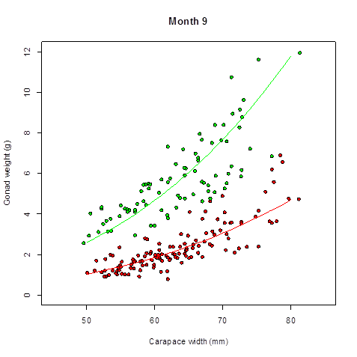
Gonad development groups and maturity and reproductive cycles:
As was the case for individual fecundity, a plot of gonad weight versus crab size often reveals the presence of multiple groups.
The existence of these gonad size groups may be due to one or more of the following processes:
presence of multiple maturity stages (e.g. primiparous and multiple),
the presence of multiple reproductive cycles (i.e. annual and biennial),
and/or the presence of first and second incubation year females in a biennial reproductive cycle.
Gonad weight and colour also have cyclical seasonal components.
3rd group?
Maturity
Example of gonad weight versus crab size from a female fecundity data set from September, 2002. There are two, possibly three distinct groups in the data. Colours indicate a grouping derived from a clustering methods assuming two groups. The arrow shows a possible 3rd group in the data.
Reproductive cycle
Gonad
Incubation year

Slide 11
Reproductive cycle schedules:
Timing
Pubescent
Year 0
Annual cycle
Biennial cycle
Primiparous – 1st clutch
Primiparous - 1st year of first clutch
Year 1 - Feb to Mar
?
Primiparous – 2nd year of first clutch
Multiparous – 2nd clutch
Year 2 – May to Jul
Maturation age cannot be reliably estimated for multiparous females in an annual cycle.
Multiparous – 3rd clutch
Multiparous - 1st year of second clutch
Year 3 – May to Jul
It seems unlikely that females would have 3rd or 4th egg clutches. This is somewhat unrealistic and has no supporting evidence.
Multiparous – 4th clutch
Multiparous - 2nd year of second clutch
Year 4 – May to Jul

Slide 12








Bayesian fecundity model (Shell conditions 1,2 & 3):
Priors
$$p_{z}$$
$$Z \sim Bern(p_{z})$$
Maturity stage indicator
$$α$$
Crab size
$$μ=α_{z}+β_{z}lnx$$
x
Log-linear mean
$$β$$
$$σ$$
$$F \sim LN(μ,σ)$$
Fecundity regression
$$F$$
Fecundity
Sample weight & count
f_{s}
w_{s}
W
Egg weight

Slide 13











Bayesian fecundity model (Shell conditions 4 & 5):
Crab size
$$p_{s}$$
x
Log-linear mean
$$α$$
$$S\sim Bern(p_{s})$$
Senility indicator
$$μ=S×L×(α+βlnx)$$
$$β$$
Log-linear mean
$$a_{L}$$
$$L\sim Beta(a_{L},b_{L})$$
Egg loss
$$b_{L}$$
$$σ$$
$$F \sim LN(μ,σ)$$
Fecundity regression
$$F$$
Fecundity
Sample weight & count
f_{s}
w_{s}
W
Egg weight

Slide 14
Reproductive processes : Annual cycle
Year 1
Year 2
Year 3
J
F
M
A
M
J
J
A
S
O
N
D
J
F
M
A
M
J
J
A
S
O
N
D
J
F
M
A
M
Maturity
Primiparous
Multiparous
Carapace condition
1-2
2
3
4
Egg stage
Extrusion
Incubation (stages 1-14)
Hatch
Incubation (stages 1-14)
Hatch
Egg colour
Clear orange
Orange - dark orange
Black
Orange - dark orange
Black
Egg loss
High at laying
Unknown but positive rate
High
Unknown but positive rate
High
Gonad colour
Beige / OC
Orange
Beige / OC
Orange
Beige / OC
Gonad weight
Low
Increasing weight
Low
Increasing weight
Low
Hepato colour
Watery
Green - dark /forest green
Watery
Green - dark /forest green
Watery
Hepato weight
Small flacid
Increasing weight – Decrease during winter?
small
Increasing weight – Decrease during winter?
small
References:
1) Reproductive Cycle and Fecundity of Primiparous and Multiparous Female Snow Crab, Chionoecetes opilio, in the Northwest Gulf of Saint Lawrence. https://cdnsciencepub.com/doi/10.1139/f93-240.
2) Fecundity and duration of egg incubation for multiparous female snow crabs (Chionoecetes opilio) in the fjord of Bonne Bay, Newfoundland. https://cdnsciencepub.com/doi/pdf/10.1139/f99-044.
3) Reproductive ecology of female snow crab (Chionoecetes opilio) in the Barents Sea. https://munin.uit.no/bitstream/handle/10037/13558/thesis.pdf?isAllowed=y&sequence=2.
4) Embryo development and reproductive cycle in the snow crab, Chionoecetes opilio (Crustacea: Majidae), in the southern Gulf of St. Lawrence, Canada. https://cdnsciencepub.com/doi/10.1139/z98-147.

Slide 15
Reproductive processes : Biennial cycle
Year 1
Year 2
Year 3
J
F
M
A
M
J
J
A
S
O
N
D
J
F
M
A
M
J
J
A
S
O
N
D
J
F
M
A
M
Maturity
Primiparous
Multiparous
Carapace condition
1-2
2
3
4
Egg stage
Extrusion
Incubation (stages 1-7)
Incubation (stages 8-14)
Hatch
Egg colour
Clear orange
Orange - dark orange
Black
Egg loss
High at laying
Unknown but positive rate
High
Gonad colour
Beige / OC
Orange
Beige / OC
Gonad weight
Low
Increasing weight
Low
Hepato colour
Watery
Green - dark /forest green
Watery
Hepato weight
Small flacid
Increasing weight – Decrease during winter?
small
References:
1) Reproductive Cycle and Fecundity of Primiparous and Multiparous Female Snow Crab, Chionoecetes opilio, in the Northwest Gulf of Saint Lawrence. https://cdnsciencepub.com/doi/10.1139/f93-240.
2) Fecundity and duration of egg incubation for multiparous female snow crabs (Chionoecetes opilio) in the fjord of Bonne Bay, Newfoundland. https://cdnsciencepub.com/doi/pdf/10.1139/f99-044.
3) Reproductive ecology of female snow crab (Chionoecetes opilio) in the Barents Sea. https://munin.uit.no/bitstream/handle/10037/13558/thesis.pdf?isAllowed=y&sequence=2.
4) Embryo development and reproductive cycle in the snow crab, Chionoecetes opilio (Crustacea: Majidae), in the southern Gulf of St. Lawrence, Canada. https://cdnsciencepub.com/doi/10.1139/z98-147.

Slide 16
Extra slides

Slide 17
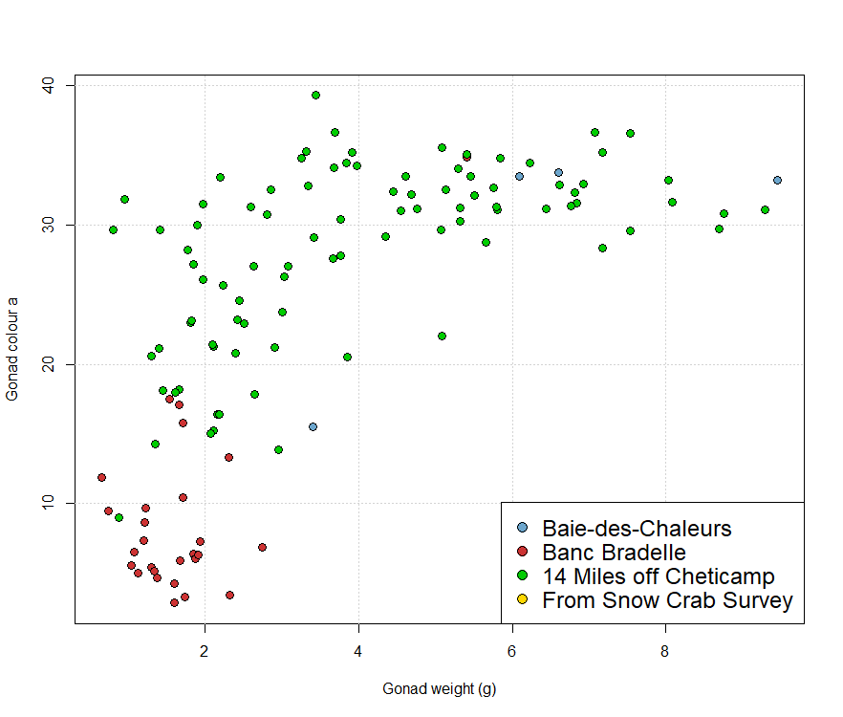

Slide 18
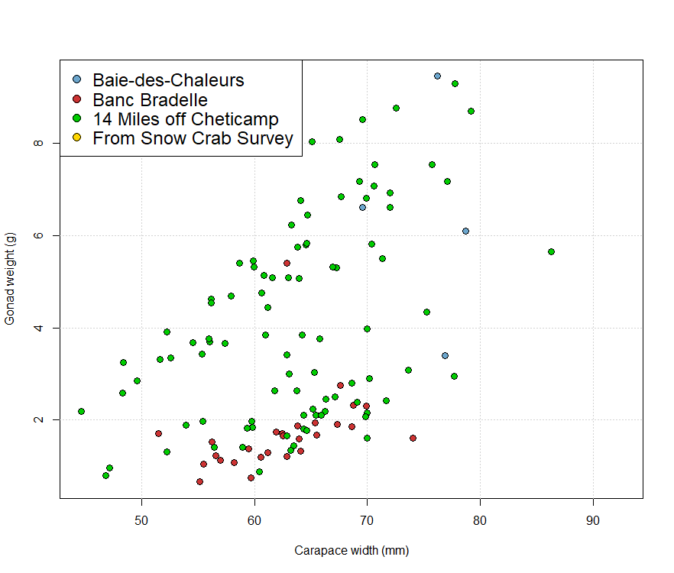

Slide 19
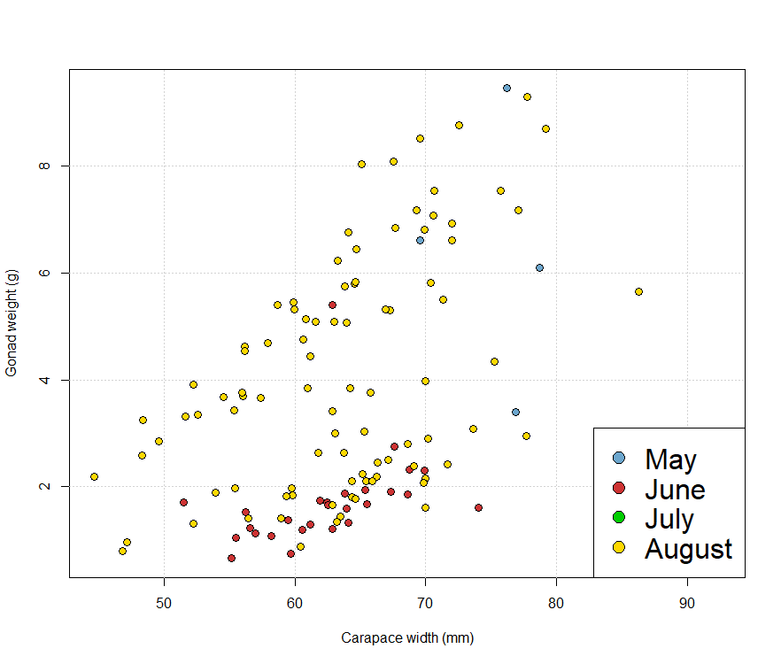

Slide 20
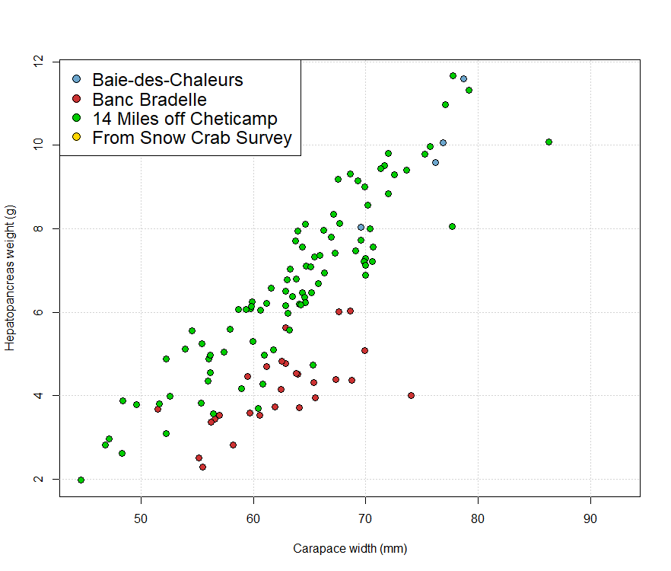

Slide 21
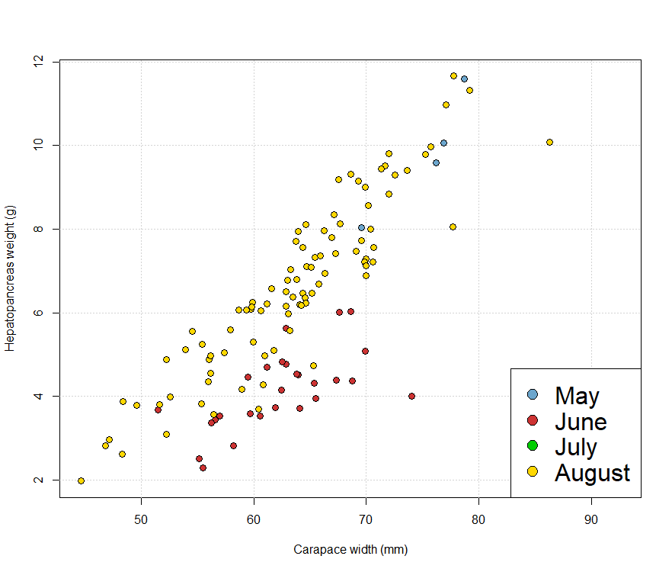

Slide 22
Year 1
Year 2
Year 3
Year 4
Year 5
Year 6
 | F | M | A | M | J | Jl | A | S | O | N | D | J | F | M | A | M | J | Jl | A | S | O | N | D | J | F | M | A | M | J | Jl | A | S | O | N | D | J | F | M | A | M | J | Jl | A | S | O | N | D | J | F | M | A | M | J | Jl | A | S | O | N | D | J | F | M | A | M | J | J | Jl
 | Mol/Mat/Spa |  |  |  |  |  |  |  |  |  |  |  |  |  |  | Hat/Mat/Spa |  |  |  |  |  |  |  |  |  |  |  | Hat/Mat/Spa |  |  |  |  |  |  |  |  |  | Hat/Mat/Spa |  |  |  |  |  |  |  |  |  |  |  |  |  | Hat/Mat/Spa |  |  |  |  |  |  |  |  |  |  | Hat/Mat/Spa
 | P1/1 |  |  |  |  |  |  |  |  |  |  |  |  |  |  | P1/1
 |  |  |  |  |  |  |  |  |  |  |  |  |  |  |  |  | M1/1 |  |  |  |  |  |  |  |  |  |  | M1/1
 |  |  |  |  |  |  |  |  |  |  |  |  |  |  |  |  |  |  |  |  |  |  |  |  |  |  |  |  | M2/1 |  |  |  |  |  |  |  |  | M2/1
 |  |  |  |  |  |  |  |  |  |  |  |  |  |  |  |  |  |  |  |  |  |  |  |  |  |  |  |  | M2/2 |  |  |  |  |  |  |  |  |  |  |  |  |  |  |  |  |  |  |  |  |  |  | M2/2
 |  |  |  |  |  |  |  |  |  |  |  |  |  |  |  |  |  |  |  |  |  |  |  |  |  |  |  |  |  |  |  |  |  |  |  |  |  |  | M3/1 |  |  |  |  |  |  |  |  |  |  |  |  | M3/1
 |  |  |  |  |  |  |  |  |  |  |  |  |  |  |  |  |  |  |  |  |  |  |  |  |  |  |  |  |  |  |  |  |  |  |  |  |  |  | M3/2 |  |  |  |  |  |  |  |  |  |  |  |  |  |  |  |  |  |  |  |  |  |  |  | M3/2
 |  |  |  |  |  |  |  |  |  |  |  |  |  |  |  |  | M1/2 |  |  |  |  |  |  |  |  |  |  |  |  |  |  |  |  |  |  |  |  | M1/2
 |  |  |  |  |  |  |  |  |  |  |  |  |  |  |  |  |  |  |  |  |  |  |  |  |  |  |  |  |  |  |  |  |  |  |  |  |  |  | M2/1 |  |  |  |  |  |  |  |  |  |  |  |  | M2/1
 |  |  |  |  |  |  |  |  |  |  |  |  |  |  |  |  |  |  |  |  |  |  |  |  |  |  |  |  |  |  |  |  |  |  |  |  |  |  | M2/2 |  |  |  |  |  |  |  |  |  |  |  |  |  |  |  |  |  |  |  |  |  |  |  | M2/2
 | P1/2 |  |  |  |  |  |  |  |  |  |  |  |  |  |  |  |  |  |  |  |  |  |  |  |  |  |  | P1/2
 |  |  |  |  |  |  |  |  |  |  |  |  |  |  |  |  |  |  |  |  |  |  |  |  |  |  |  |  | M1/1 |  |  |  |  |  |  |  |  | M1/1
 |  |  |  |  |  |  |  |  |  |  |  |  |  |  |  |  |  |  |  |  |  |  |  |  |  |  |  |  |  |  |  |  |  |  |  |  |  |  | M2/1 |  |  |  |  |  |  |  |  |  |  |  |  | M2/1
 |  |  |  |  |  |  |  |  |  |  |  |  |  |  |  |  |  |  |  |  |  |  |  |  |  |  |  |  |  |  |  |  |  |  |  |  |  |  | M2/2 |  |  |  |  |  |  |  |  |  |  |  |  |  |  |  |  |  |  |  |  |  |  |  | M2/2
 |  |  |  |  |  |  |  |  |  |  |  |  |  |  |  |  |  |  |  |  |  |  |  |  |  |  |  |  | M1/2 |  |  |  |  |  |  |  |  |  |  |  |  |  |  |  |  |  |  |  |  |  |  | M1/2
Primiparous
Extruded eggs as 1 yr or 2 yrAfter each egg extrusion, a female, regardless its reproductive phase, can go under 1 or 2 year cycle
P1/1: Primiparous 1st brood with 1 year cycle, P1/2: Primiparous 1st brood with 2 year cycle
M1/1: Multiparous 1st brood with 1 year cycle, M1/2: Multiparous 1st brood with 2 year cycle and so on
Primiparous extruded eggs with 1 year cycle (P1/1). Their eggs hatched 1 year later (P1/1) and mated and extruded eggs as M1/1 or M1/2
Primiparous with 2 year cycle (P1/2) hatched their eggs 2 year later (P1/2) and mated and extruded eggs as M1/1 or M1/2. They are
one year later than P1/1 group.
Multiparous M1/1 hatched their eggs in year 3 and extruded eggs as M2/1 or M2/2 and/or M1/2 hatched their eggs in year 4 and extruded
Eggs as M2/1 or M2/2. They are one year later than M2/1 group

Slide 23











Bayesian fecundity model:
Weight precision
Sample egg weight
$$w_{s}^{′}$$
$$p_{w}$$
$$W′$$
Total egg weight
$x \sim U(x′−p_{x},x′+p_{x})$)
$$p_{x}$$
$$w_{s} \sim U(w_{s}^{′}−p_{w},w_{s}^{′}+p_{w})$$
$W \sim U(W′−p_{w},W′+p_{w})$)
Maturity stage
Fecundity
$$n_{s}$$
$$F=\frac{W}{w_{s}} n_{s}$$
$$F \sim LN(μ,σ)$$
Reproductive cycle
Gonad colour
Sample egg count
Elapsed incubation time
Egg development stage
$$μ=(1−L)α_{msy}x^{β}$$
Site x year
Mortality
L
Sampling loss

